Slide 1
Fault-Tolerant Flash ADC Architecture
for Edge IoT Devices
Submitted by:
Pranav.M,
Rohan.M,
Rizwan
Sayooj
Under the guidance of:
Dr. Ngangbam Phalguni Singh and Dr. Vijay Rao Kumbhare

Slide 2
Introduction: ADCs in IoT and Edge Devices
The Internet of Things (IoT) demands low-power, reliable data converters for edge devices. Analog-to-Digital Converters (ADCs) are crucial interfaces for digital processing units, as sensors produce analog signals.
Motivation for Low-Bit Flash ADCs
Problem Statement: Speed + Fault Detection
For immediate event detection or threshold monitoring, high-speed conversion is prioritized over high resolution. Flash ADCs are ideal due to their near-instantaneous conversion, especially at low resolutions (3–4 bits).
Edge devices face varying conditions like supply noise and temperature changes. Conventional Flash ADCs can fail under reference drift. A solution balancing speed, low power, and robustness against reference faults is needed.

Slide 3
Project Objective: Fault-Tolerant 3-bit Flash ADC
This project implements a 3-bit Flash ADC in Cadence Virtuoso, built with analog blocks (resistor ladder, comparators, encoder). A fault-detection block monitors the reference voltage (Vref) and flags instability.
Why 3-bit Resolution for IoT?
Design Advantages
Keeps comparator count low (7 comparators).
Simplicity: Straightforward structure.
Provides fast response with minimal silicon area.
Speed: One-step conversion.
Sufficient for threshold-based IoT sensing and edge-triggered applications.
Fault Tolerance: Reference monitoring enhances robustness.

Slide 4



ADC Roles and Requirements in IoT
IoT edge devices interface with diverse sensors, converting analog signals under strict resource constraints. Key requirements include ultra-low power, sufficient resolution, appropriate sampling rates, low cost, and seamless integration.
Ultra-low power
Sufficient Resolution
Essential for battery-powered or energy-harvested devices.
Accuracy tailored to sensor type and application needs.
Sampling Rate & Latency
Low Cost & Compact Area
Optimized for specific application demands.
Critical for mass-produced IoT devices.

Slide 5
Comparative Analysis of ADC Architectures for IoT
SAR
Medium (8–12b)
Moderate
Low
Excellent for general sensing
Balanced, most common in IoT nodes.
Delta-sigma
High (16–24b)
Low
Medium
Best for precision sensing
Not suitable for high-speed detection.
Flash
Low (3–4b)
Very High
High (but reduced at low bit count)
Suitable for event detection
Ideal for fast edge monitoring in low-resolution cases.
Pipeline
Medium–High
High
High
Not suitable
Complexity and power overhead.
Integrating
Medium
Very Low
Very Low
Not suitable for real-time
Too slow for edge IoT.

Slide 6
Justification for This Work: 3-bit Flash ADC
Despite SAR and ΣΔ ADCs being more common in IoT, this project focuses on a 3-bit Flash ADC for specific reasons:
1
Speed Demonstration
2
Educational Scope
Flash ADC is the fastest architecture, useful for exploring event-driven or trigger-based IoT circuits.
A compact 3-bit Flash design is feasible to implement and simulate in 180 nm CMOS.
3
Testing Fault-Tolerant Ideas
4
Proof-of-Concept
Adding a fault-detection block (e.g., monitoring reference voltage stability) is easier to integrate with Flash due to its simple structure.
Starting with Flash validates comparator and encoder design, building a foundation for future architectures.

Slide 7

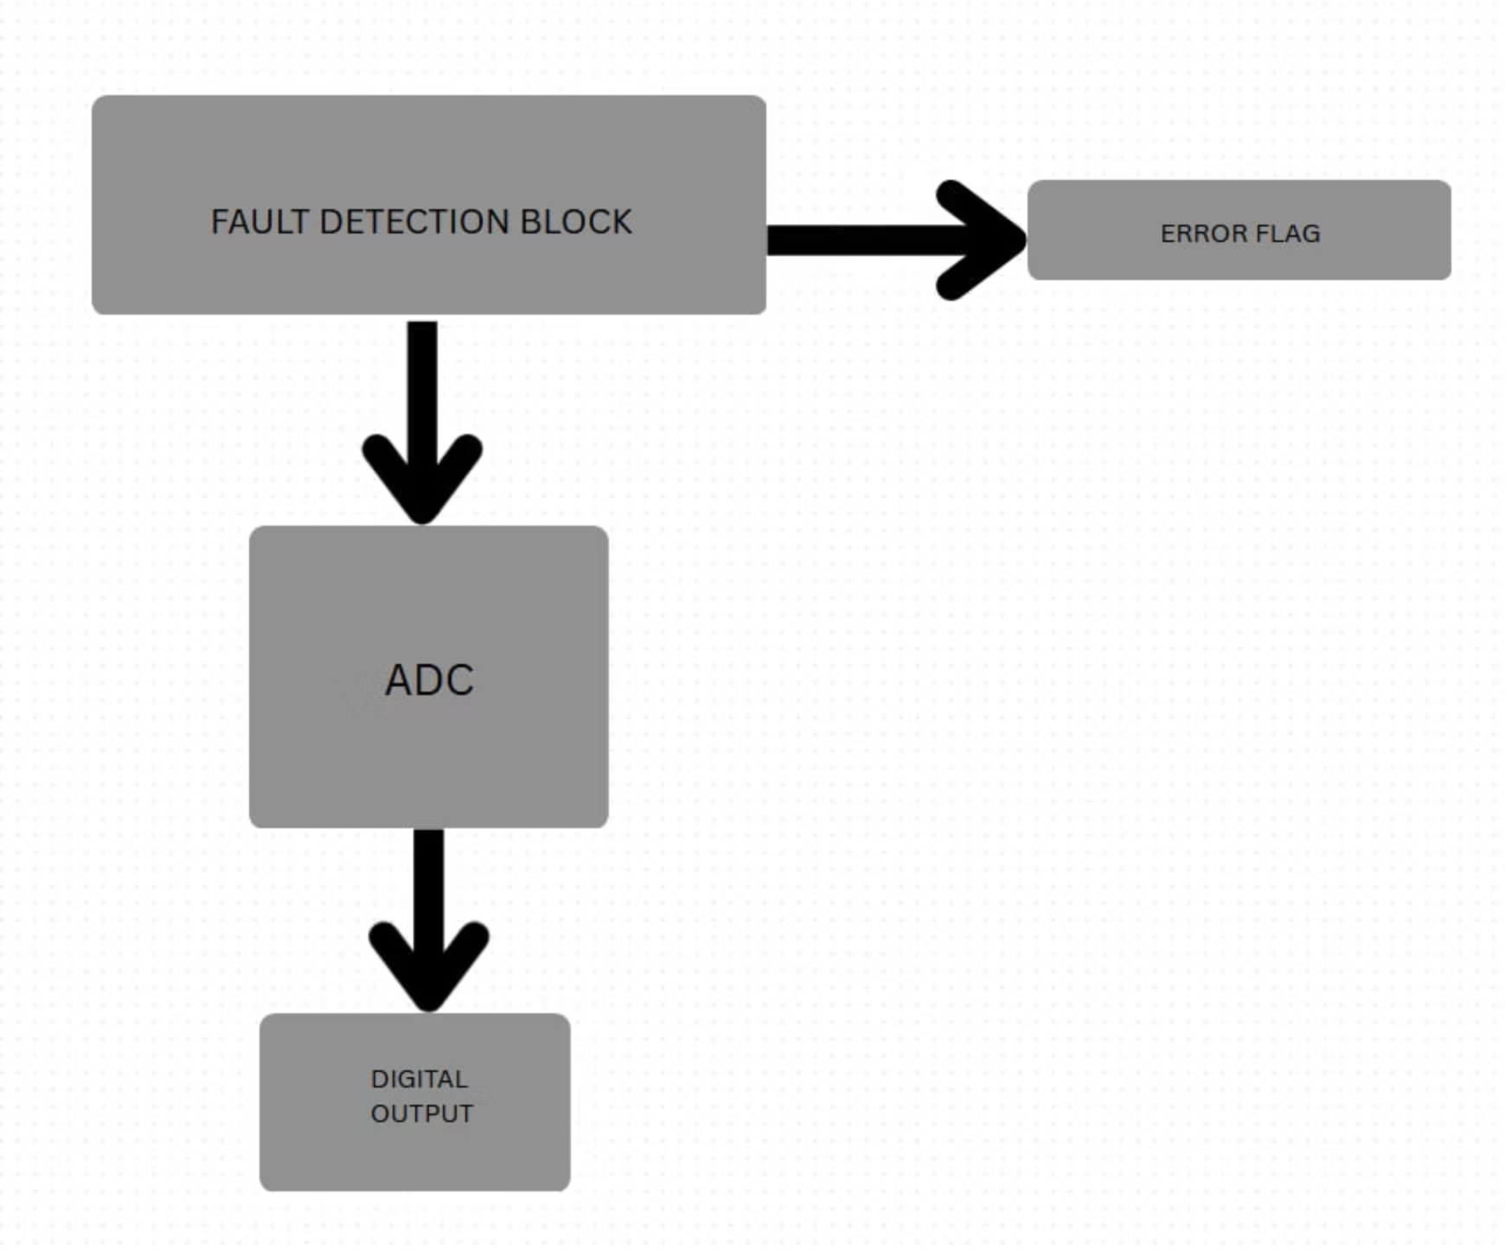
System-Level Overview: 3-bit Flash ADC
The proposed 3-bit Flash ADC system processes analog input, converts it to binary, and includes a fault detection mechanism.
Input analog voltage (Vin) is compared against reference ladder points.
Comparator outputs form thermometer code.
Encoder block converts thermometer to binary.
Fault detection monitors Vref and generates an error flag if instability occurs.

Slide 8
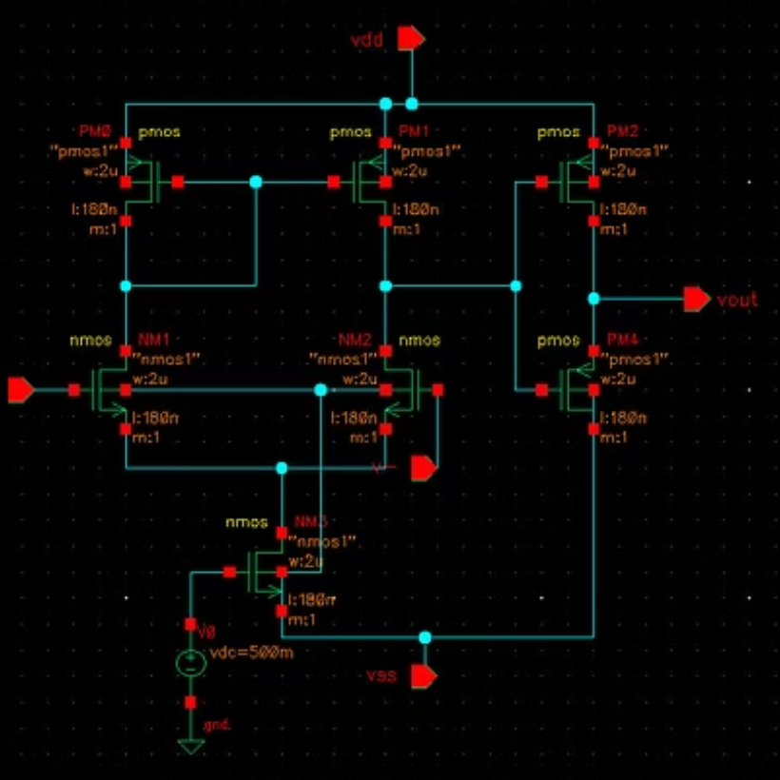
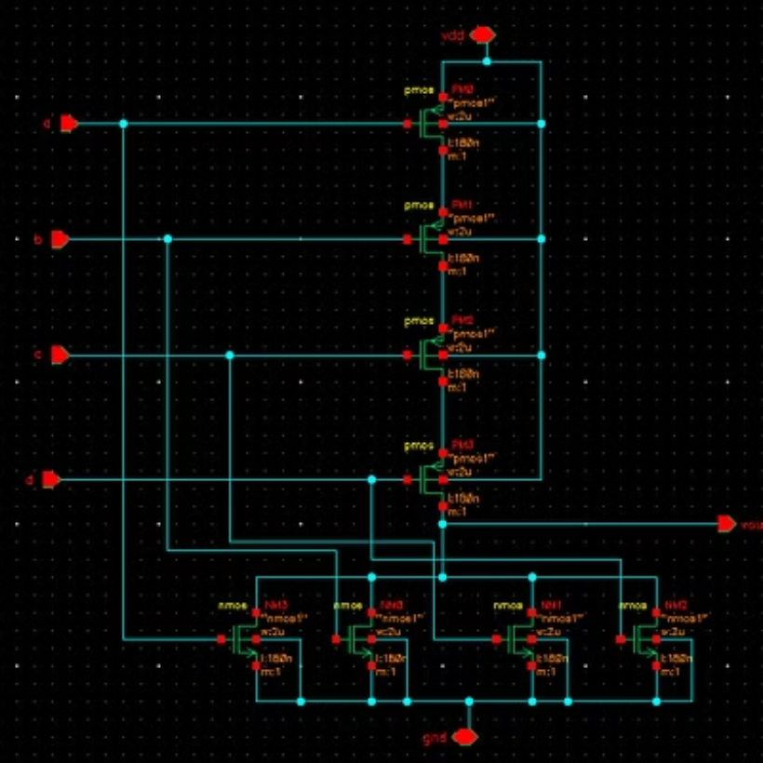

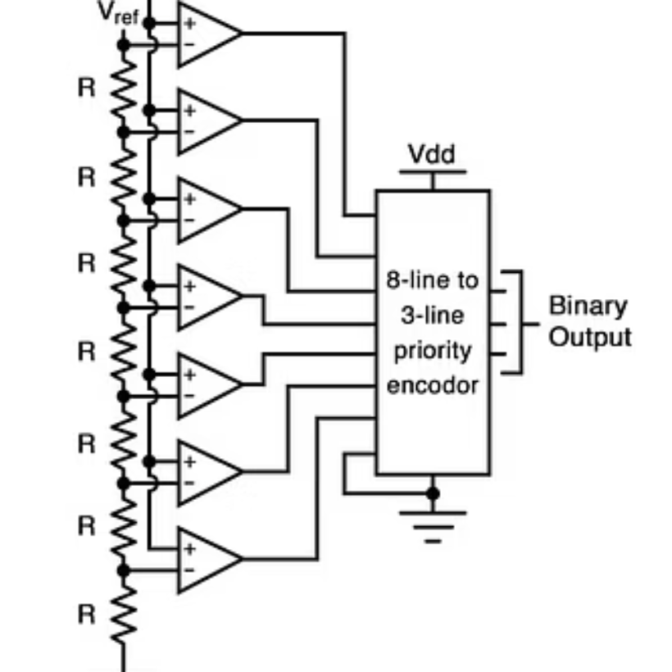
Key Circuit Components
The 3-bit Flash ADC is composed of essential analog and digital building blocks.
Comparator: Essential for comparing input voltage with reference levels.
4-input NOR Gate: Used in the digital logic of the encoder.
Priority Encoder: Converts the thermometer code from comparators into binary output.
3-bit Flash ADC: The complete integrated circuit design.

Slide 9
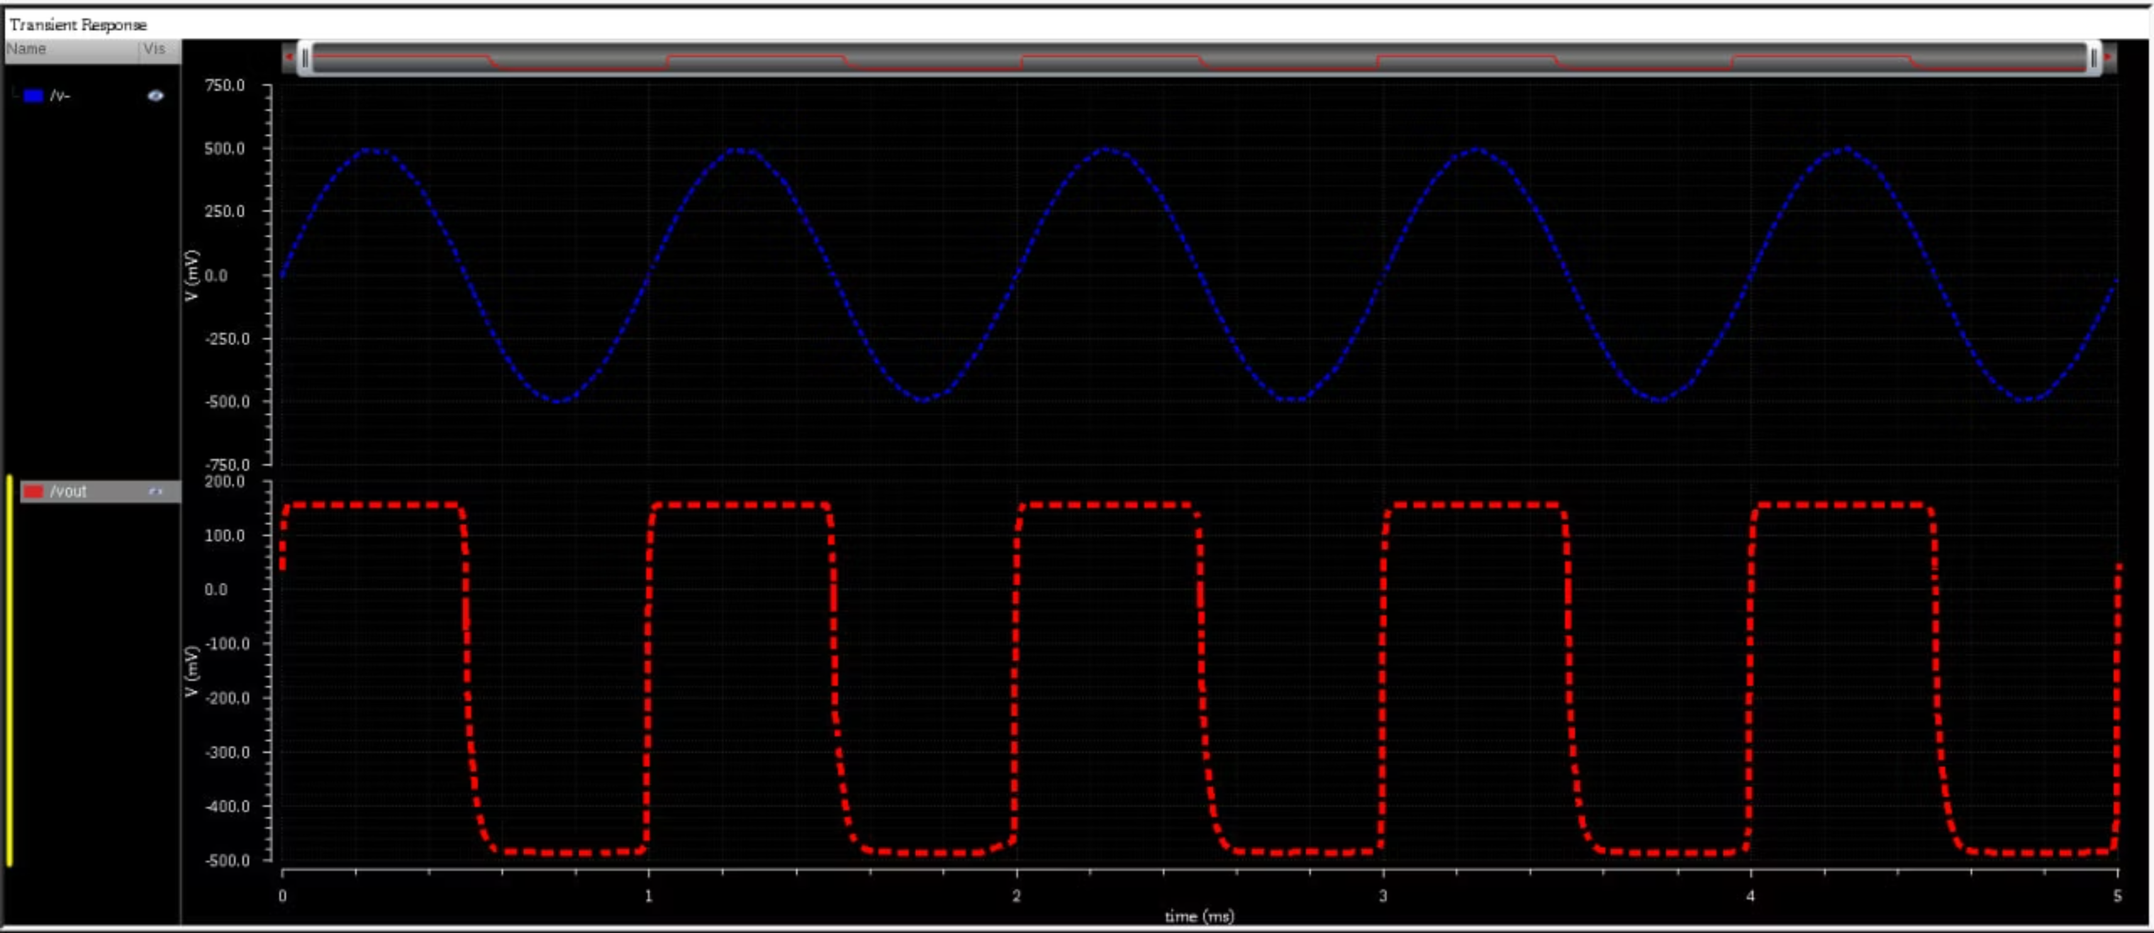
Error

Slide 10
Conclusion & Future Work
This project successfully implements a fault-tolerant 3-bit Flash ADC in Cadence Virtuoso, addressing the need for speed and robustness in edge IoT devices.
Key Achievement
Impact
Future Directions
Development of a low-bit Flash ADC with integrated reference voltage fault detection.
Enhances reliability and performance of ADCs in challenging edge environments.
Further optimization for power, area, and integration into more complex SoC designs.
References:
P. Harpe, K. A. A. Makinwa, and A. Baschirotto, Eds., *Hybrid ADCs, Smart Sensors for the IoT, and Sub-1V & Advanced Node Analog Circuit Design*. Cham: Springer, 2018.
N. H. Patel, “Power efficient 4-bit flash ADC using Cadence Virtuoso,” *International Journal of Engineering Research & Technology (IJERT)*, vol. 10, no. 3, pp. 371–376, Mar. 2021.

